Slide 1
Raw Reduction of Spectroscopic Data
季辰阳、陈瑶鑫

Slide 2
Day 1: Bias Subtraction of Magellan/PFS Day 2-3: Order Tracing using Narrowflat on PFS Day 4: Flat fielding, scattered light using Wideflat on PFS Day 5: ThAr Wavelength calibration

Slide 3
Day 1: Bias Subtraction of Magellan/PFS
1.0 Data preparation: reorient the image to our familiar direction
1.1 Bias subtraction by stacking all bias frames.
Image - Bias

Slide 4
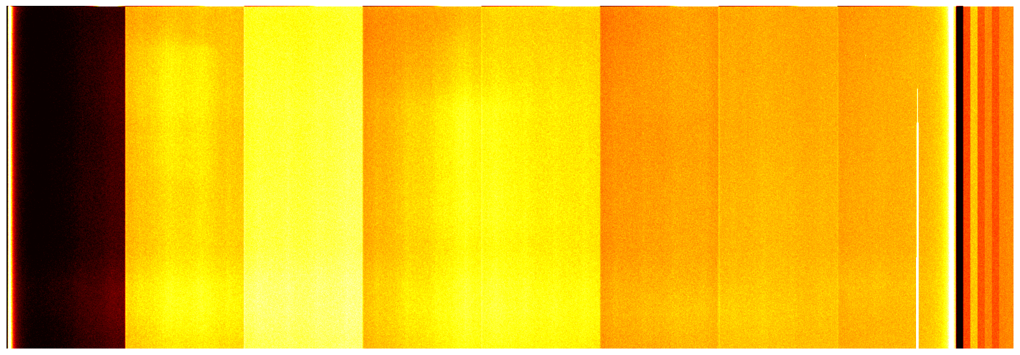
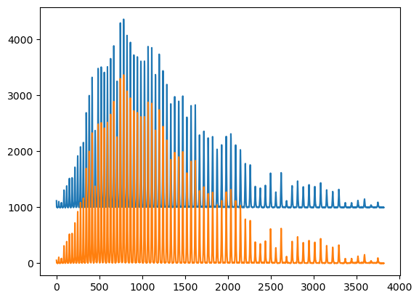
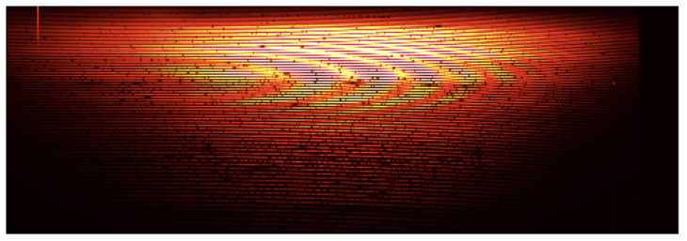
Day 1: Bias Subtraction of Magellan/PFS
Bias
Before bias subtraction
After bias subtraction
After bias subtraction
Take Column 5000 for example

Slide 5
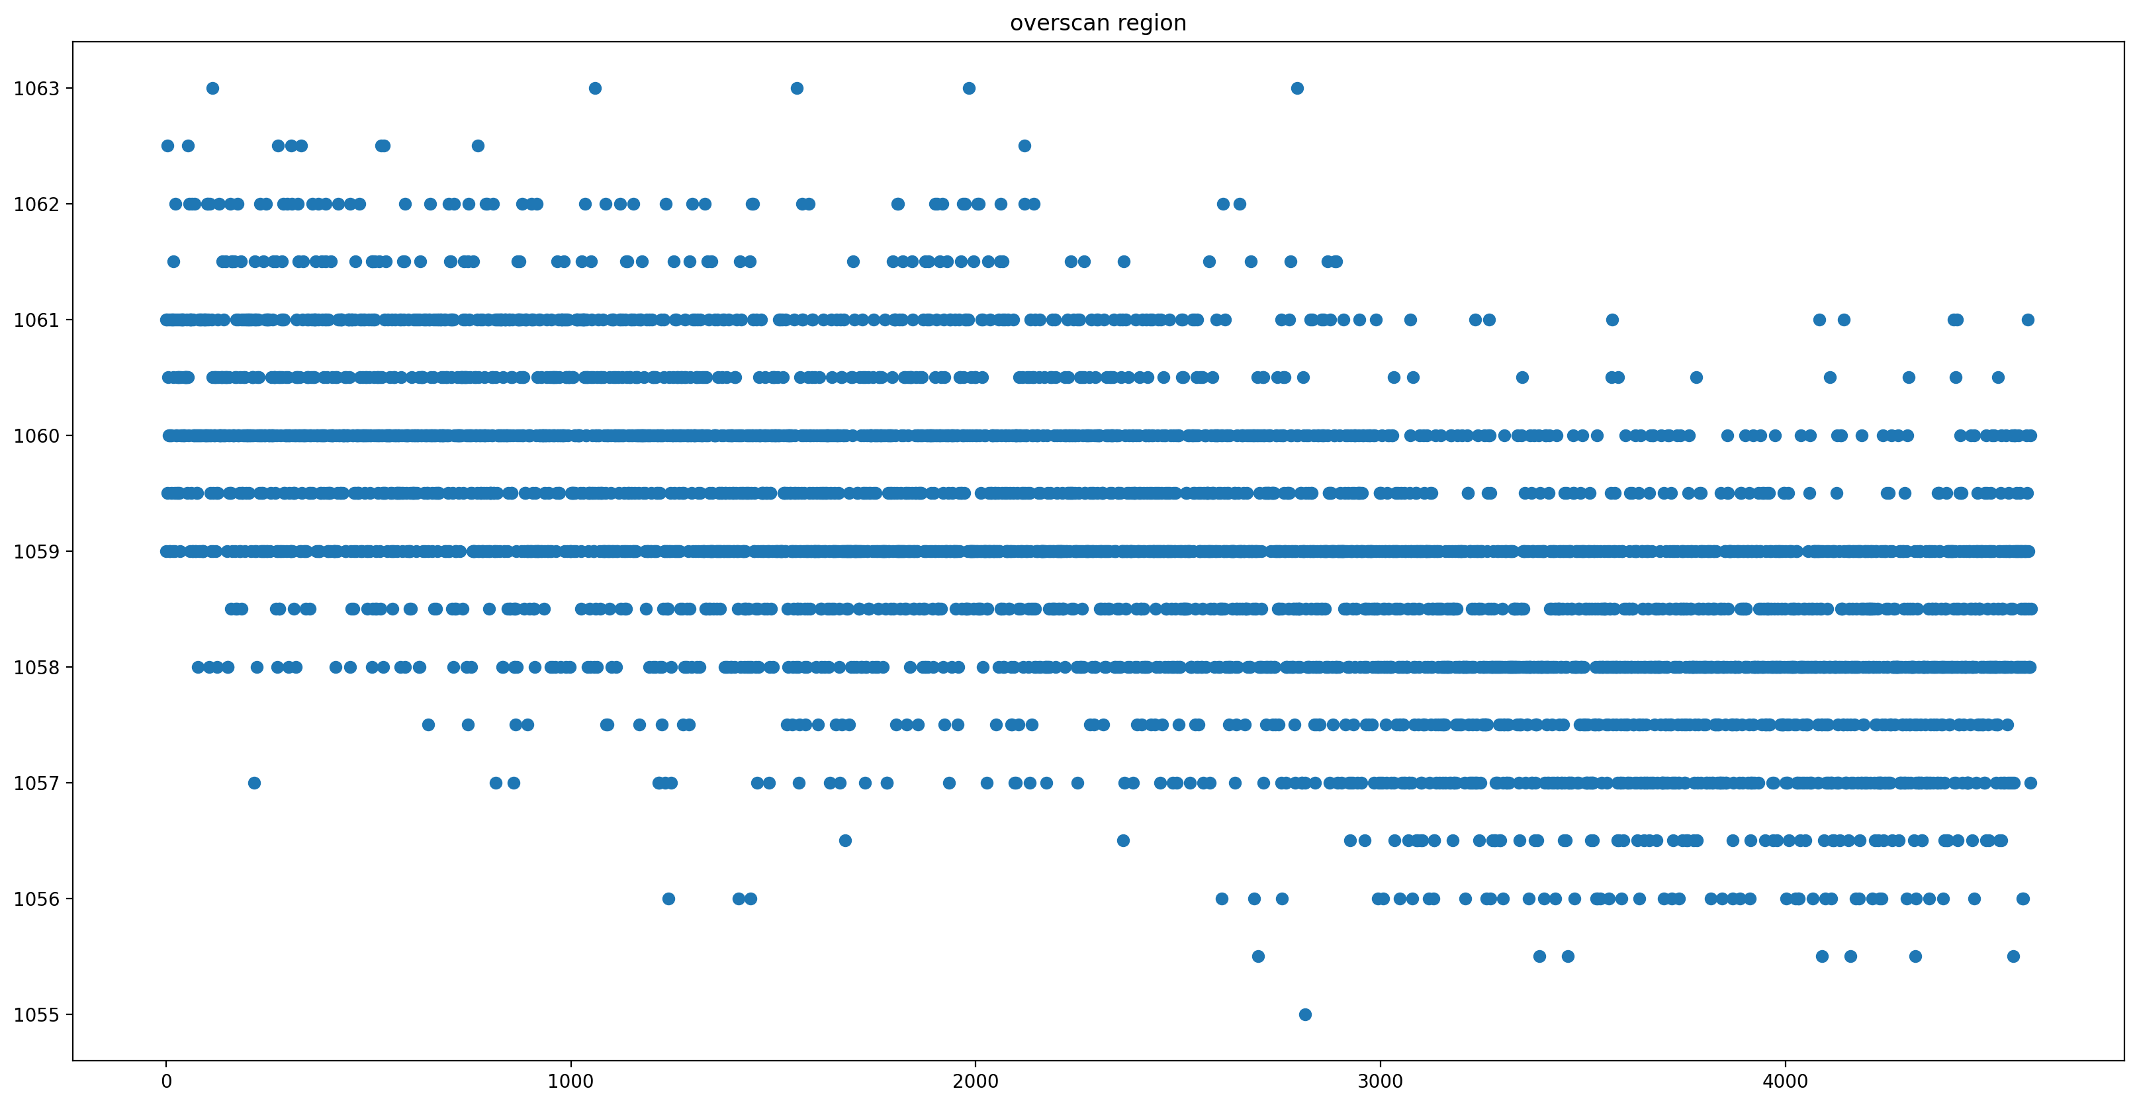
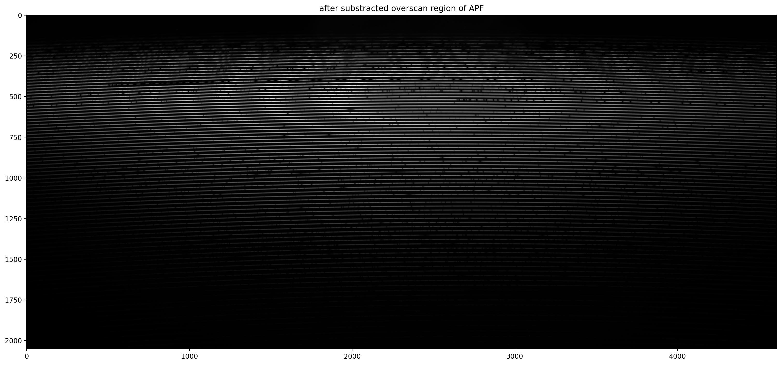
Day 1: Bias from Overscan Region of APF
30 rows on the bottom are overscan region.

Slide 6
Day 2-3: Order Tracing using Narrowflat on PFS
2.1 Take one column, and convolve with a thin Gaussian to remove wobbling of counts.
2.2 Find local maximum of 2nd derivative, to get upper and lower edges of traces. (Method 1)
2.2 Apply running window to get upper and lower edges of traces. (Method 2)
2.3 Continue with other columns, and fit a polynomial to get 2D order tracing solution.

Slide 7
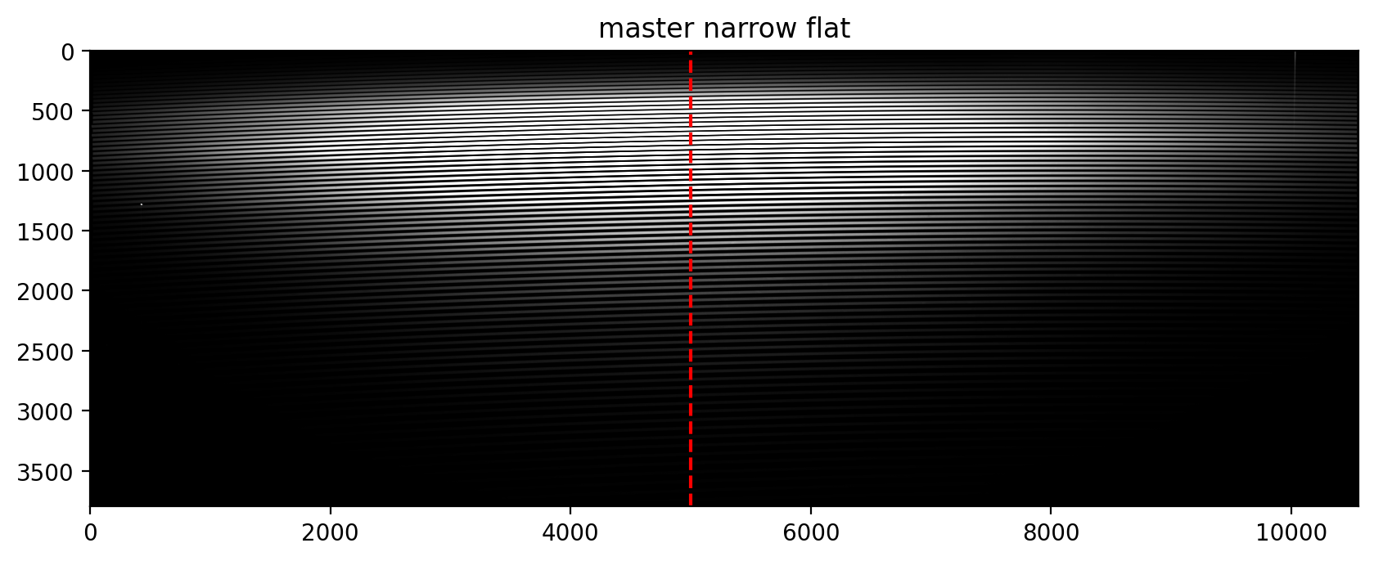
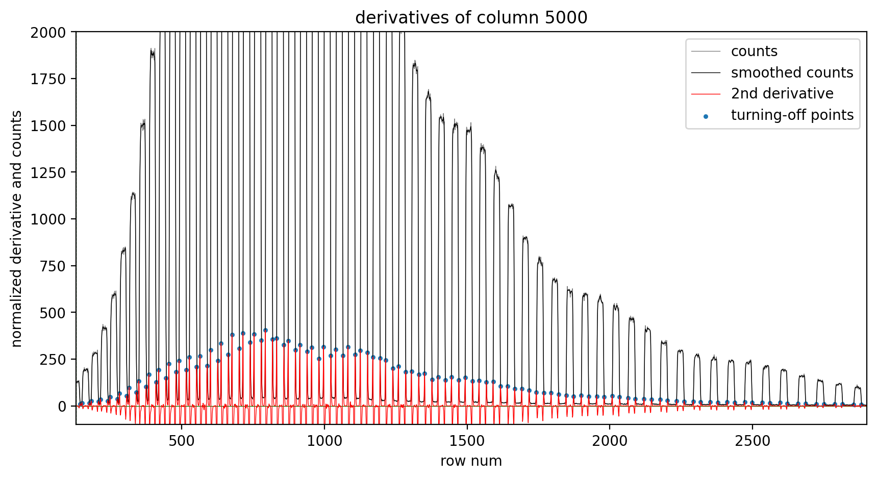
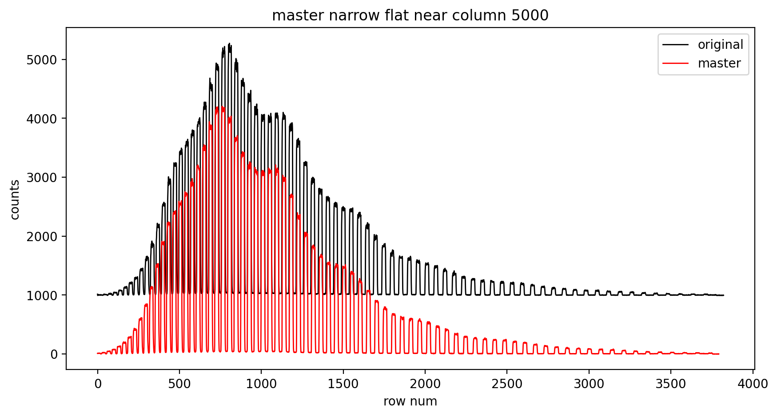
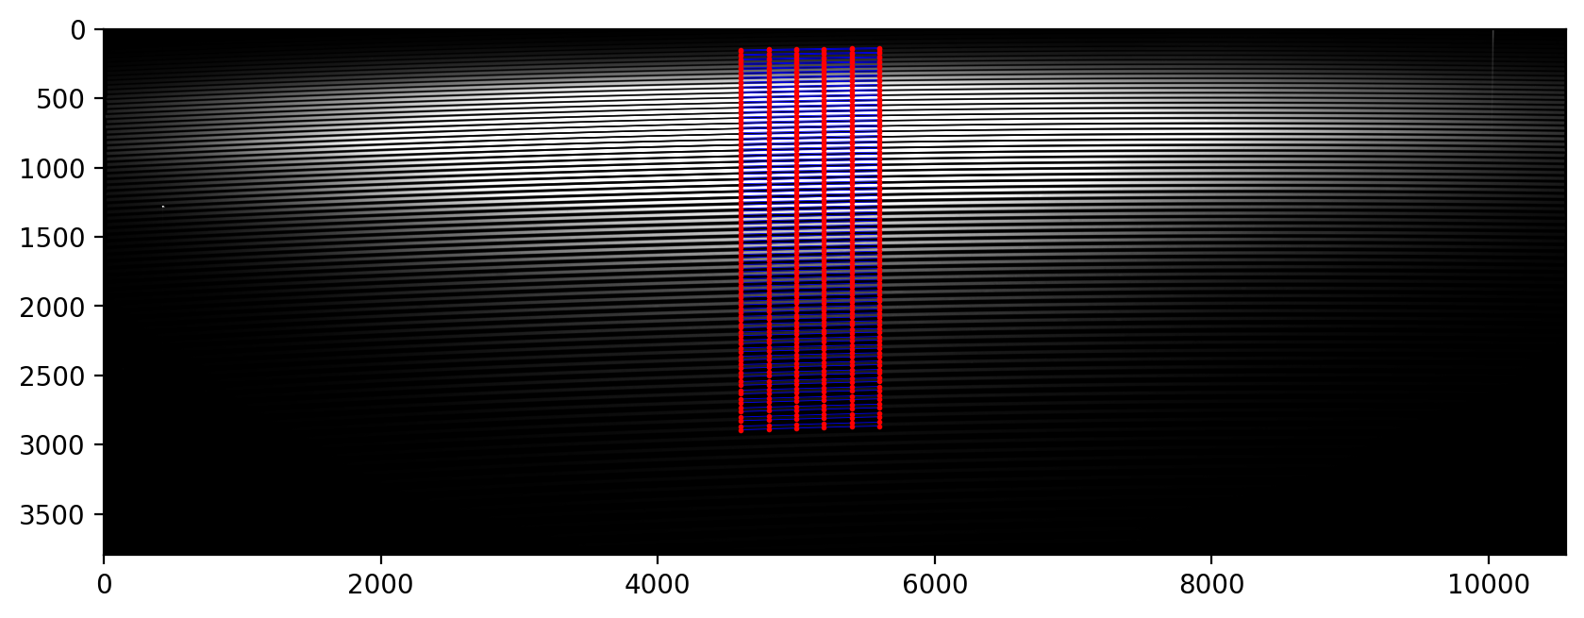
Day 2-3: Order Tracing using Narrowflat on PFS(Method 1)

Slide 8

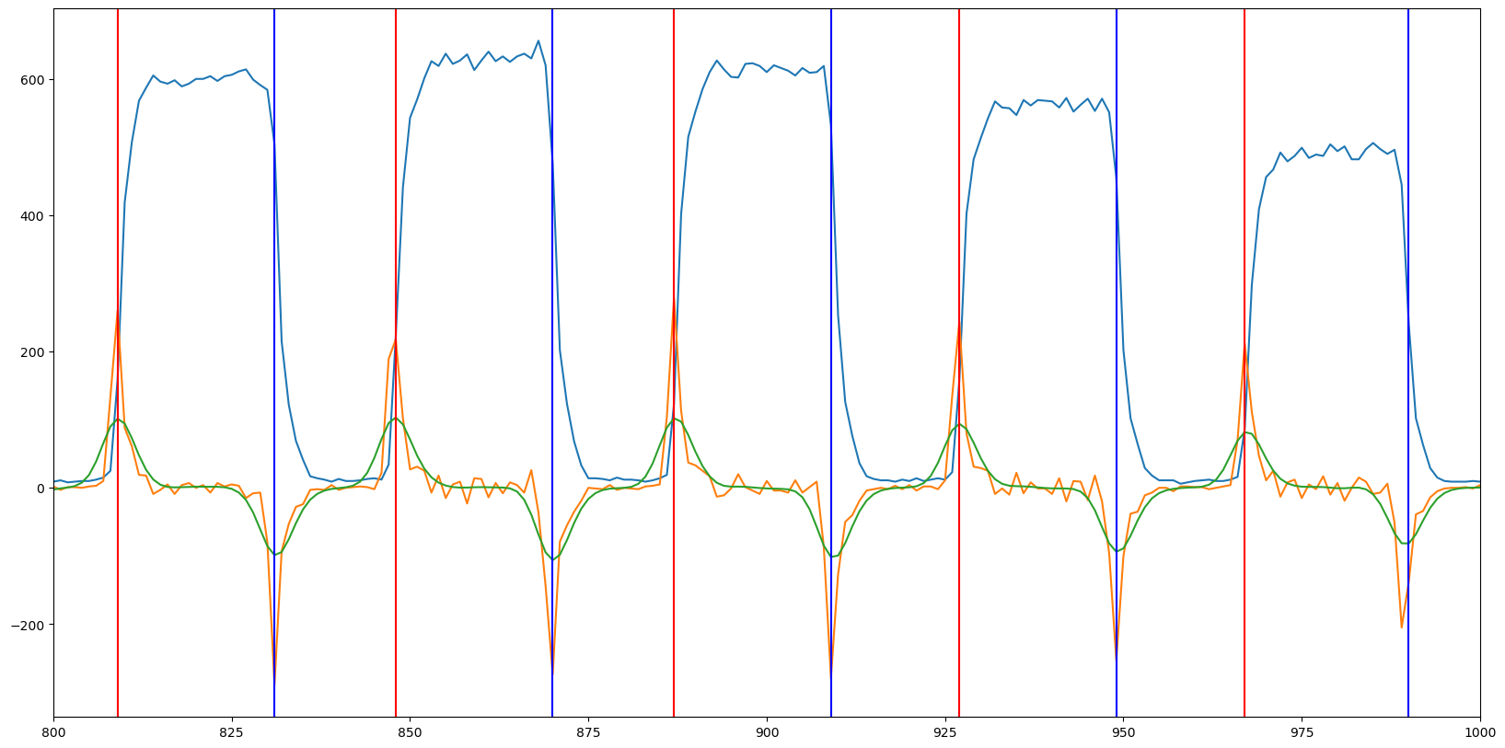
Day 2-3: Order Tracing using Narrowflat on PFS(Method 1)
NarrowFlat

Slide 9
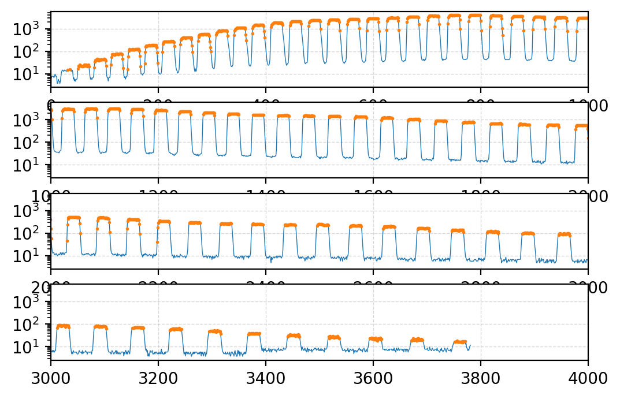
Day 2-3: Order Tracing using Narrowflat on PFS(Method 2)
Get the points with values larger than certain percentage of maximum within a 200-pixel window. (Running window)

Slide 10
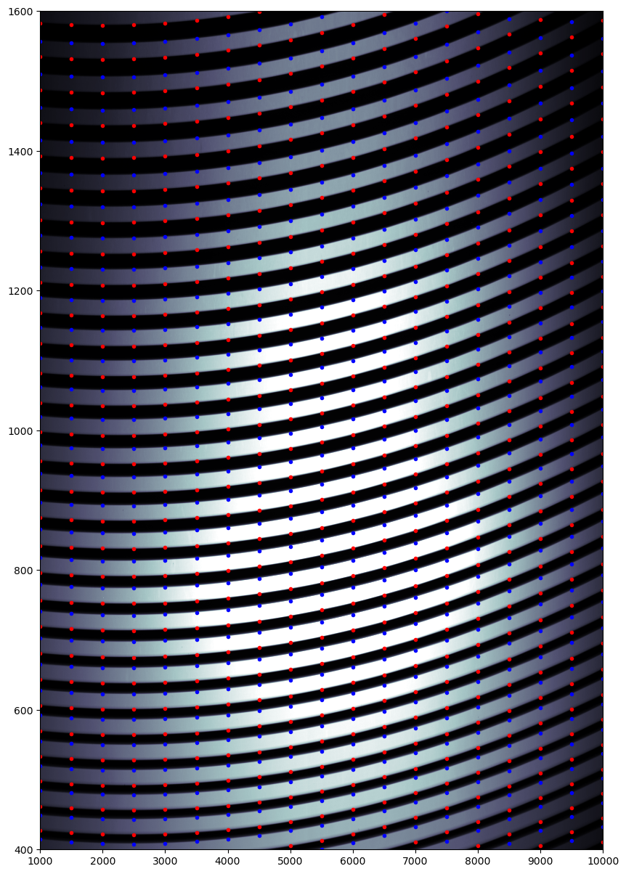
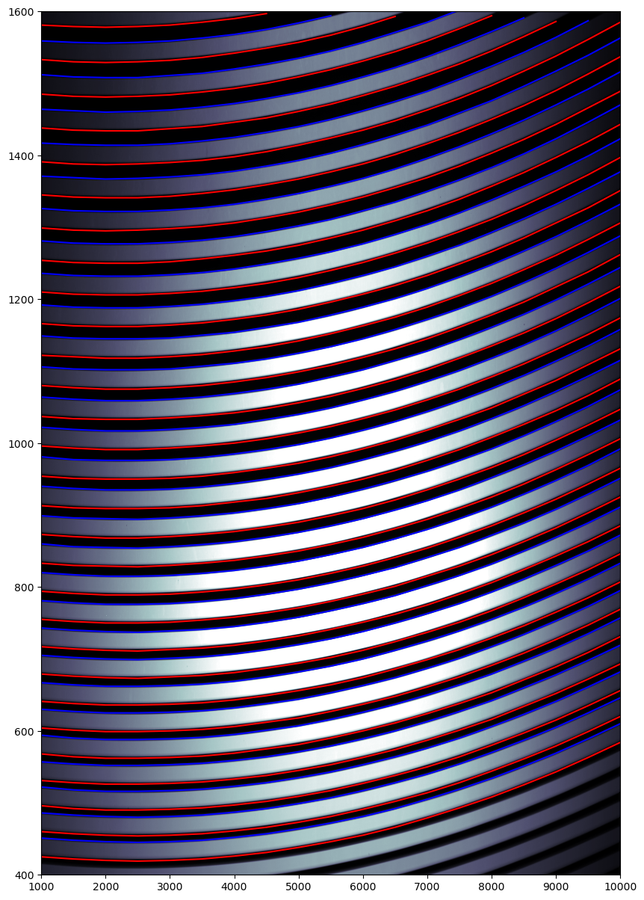
Day 2-3: Order Tracing using Narrowflat on PFS

Slide 11
Day 4: Flat fielding using Wideflat on PFS
4.1 Use the order center solution got before, make up a wider order range of +/- 14 pixels.
4.2 Values of master flat between orders are 1.
4.3 Values of master flat within orders should remove Blaze function, to reveal difference of quantum efficiency between orders.
4.4 Remove scattered light.
(Image - Bias) / Wideflat

Slide 12
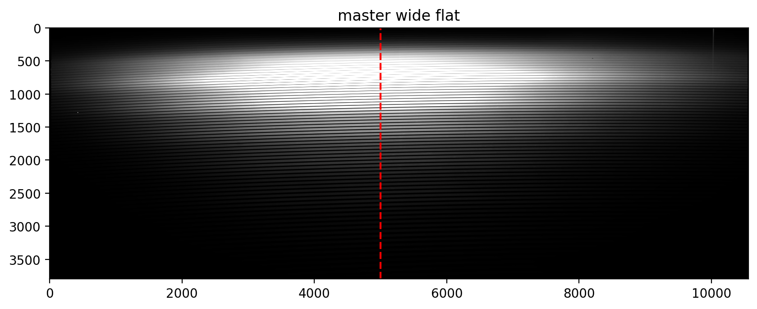
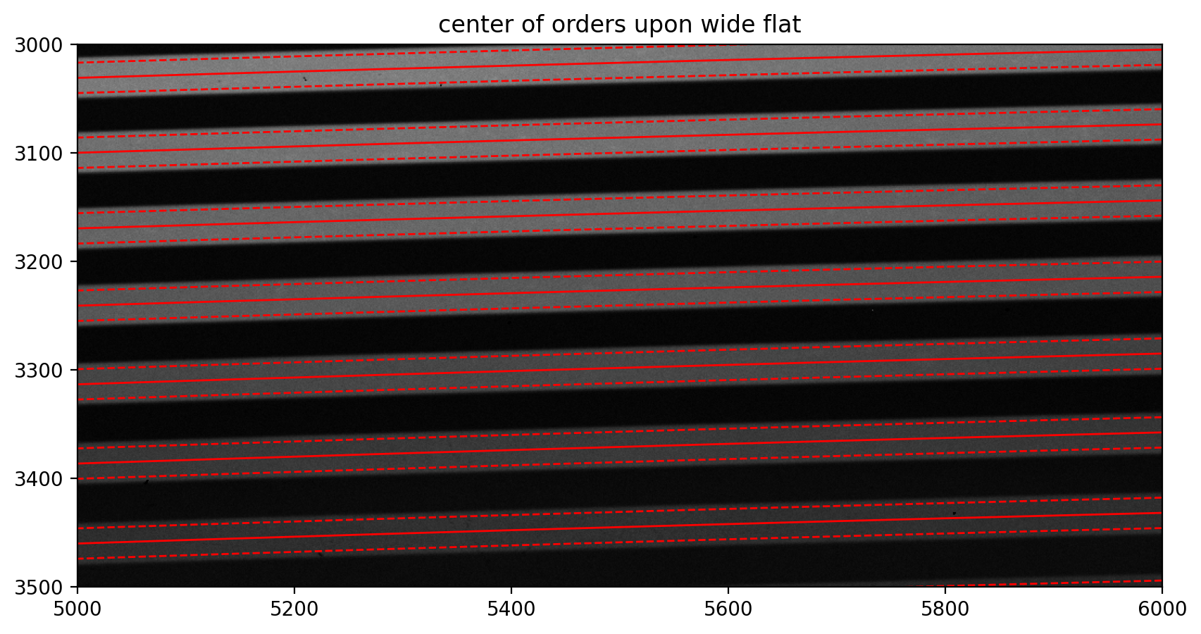
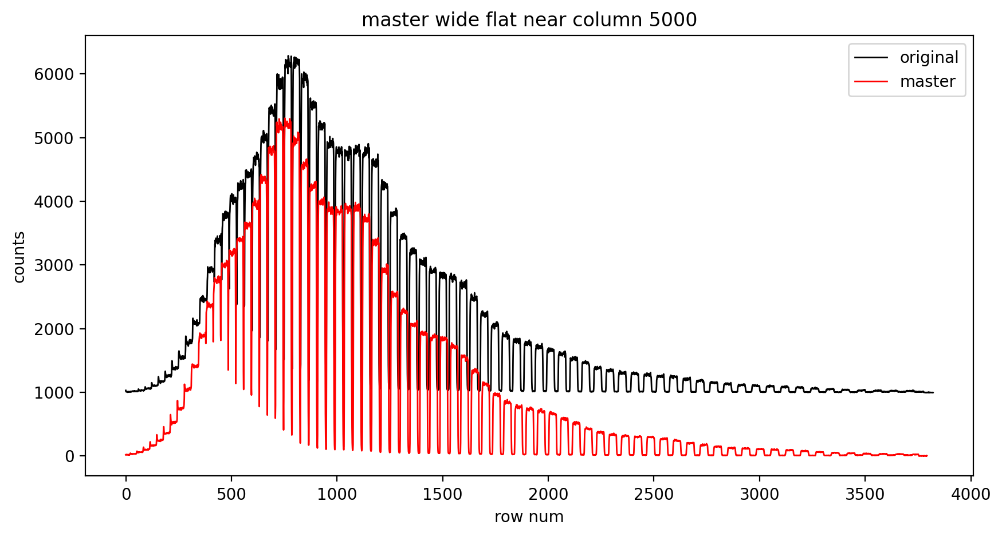
Day 4: Flat fielding using Wideflat on PFS
Scattered light

Slide 13
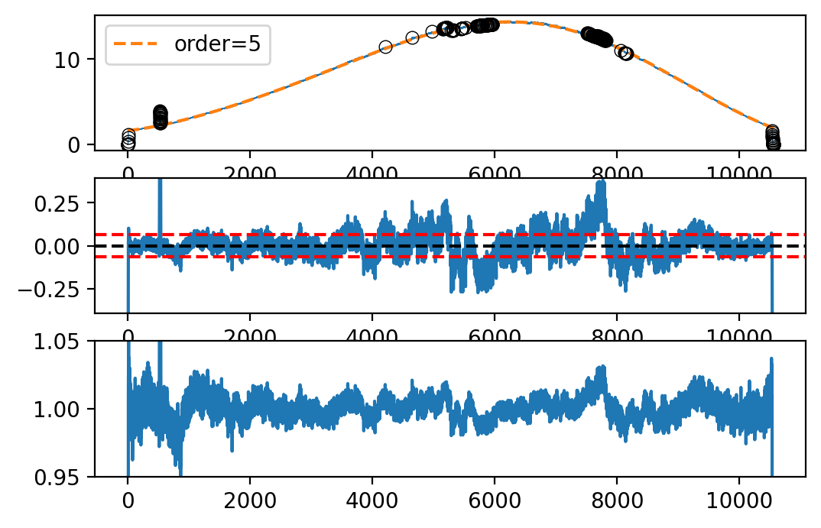
Day 4: Flat fielding using Wideflat on PFS
Counts and fit
Residual
Flat within order

Slide 14
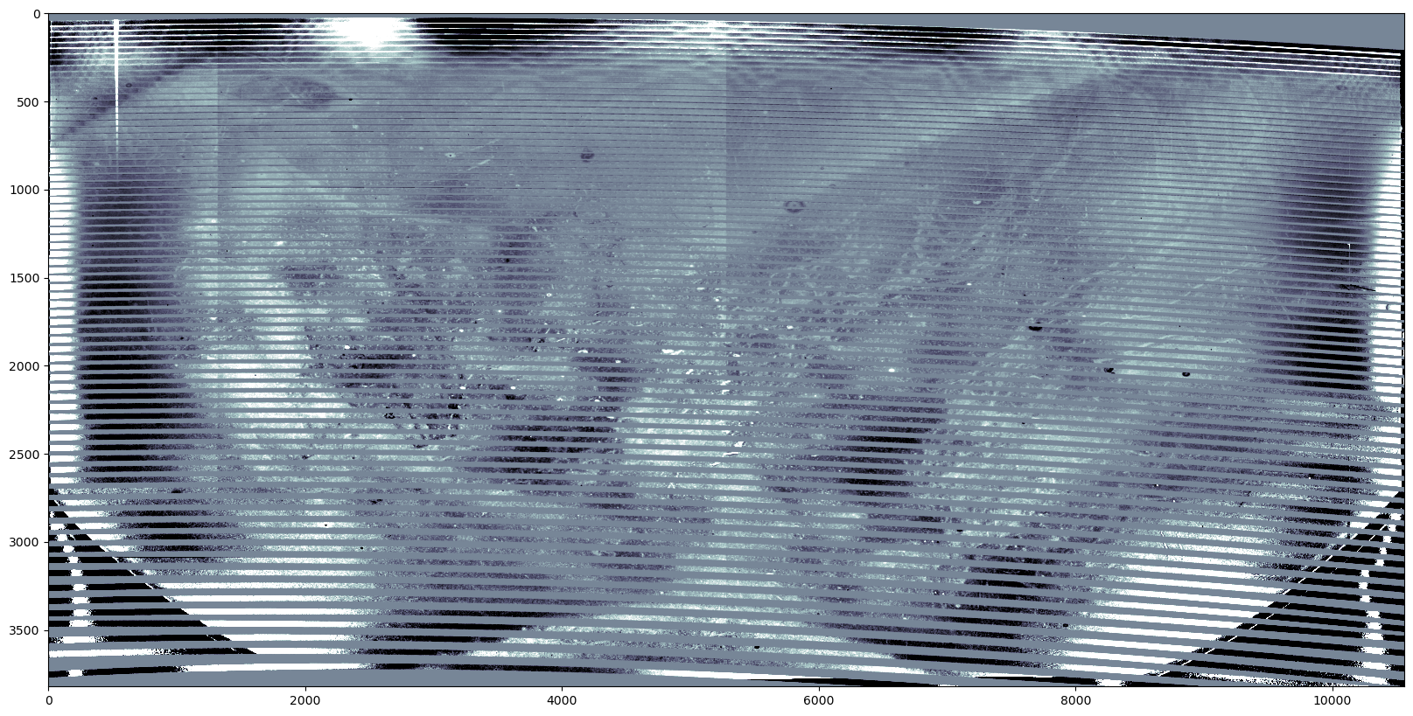
Day 4: Flat fielding using Wideflat on PFS

Slide 15
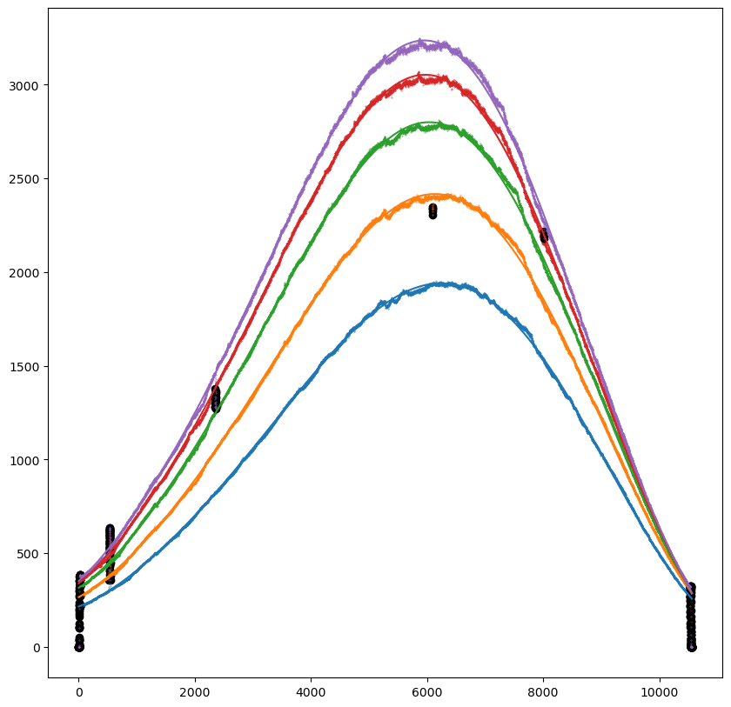
Day 4: Flat fielding using Wideflat on PFS
take five orders for example

Slide 16
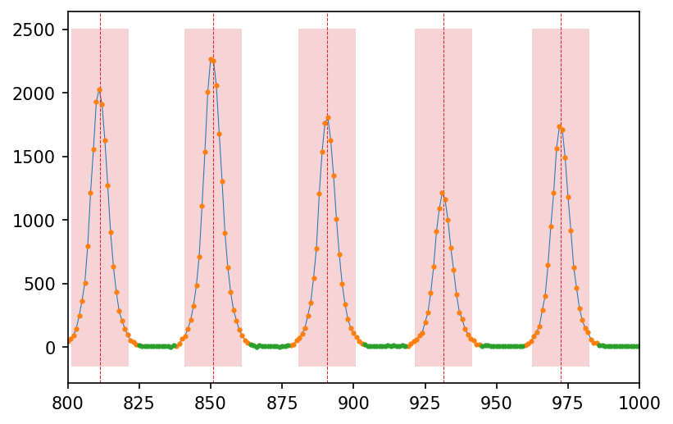
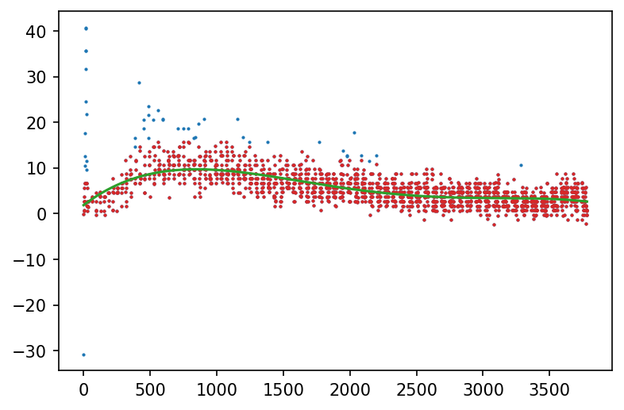
Day 4: Scattered light image
green dots——background
orange dots within the red region——signal

Slide 17
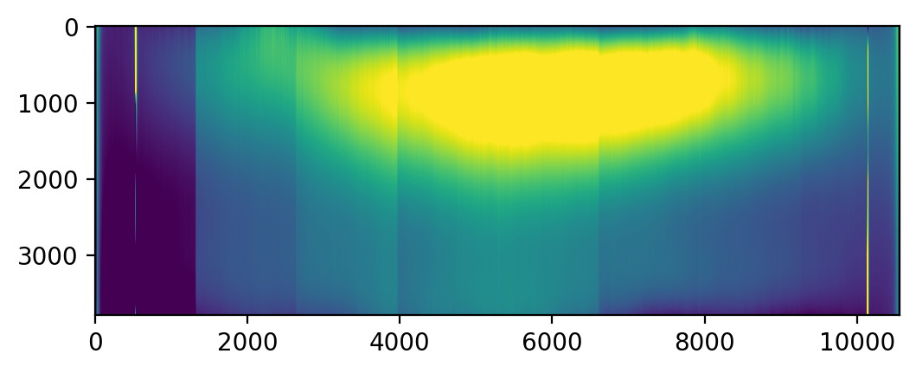
Day 4: Scattered light image

Slide 18
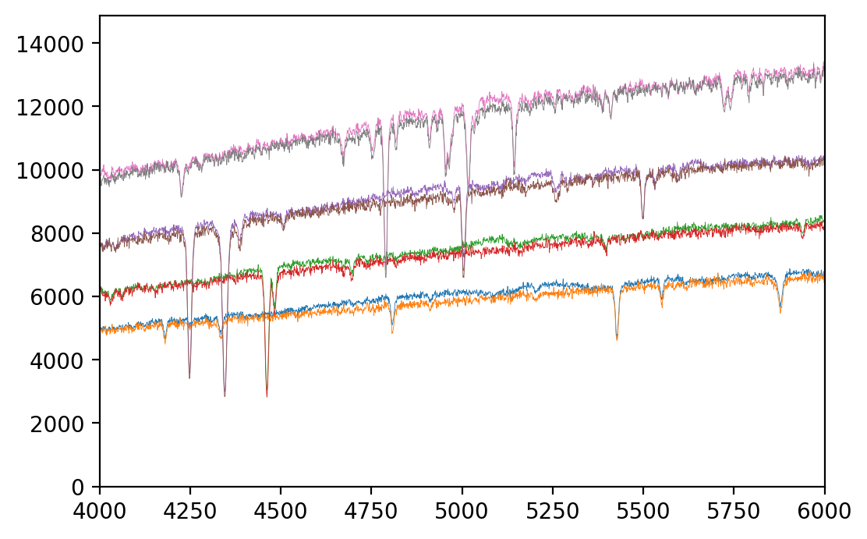
Day 4: Flat fielding using Wideflat on PFS
A comparison of spectra before and after flat fielding and scattered light removing:
Flatter and better for SED fitting

Slide 19
Day 5: ThAr Wavelength calibration
5.1 ThAr atlas from 216 HRS / some other lab spectrum.
5.2 Match observed lines with atlas, and get wavelength solution.
5.3 Do polynomial fitting of wavelength in terms of pixel, and get the final flux v.s. wavelength.
f(pix) --λ(pix)--> f(λ)

Slide 20
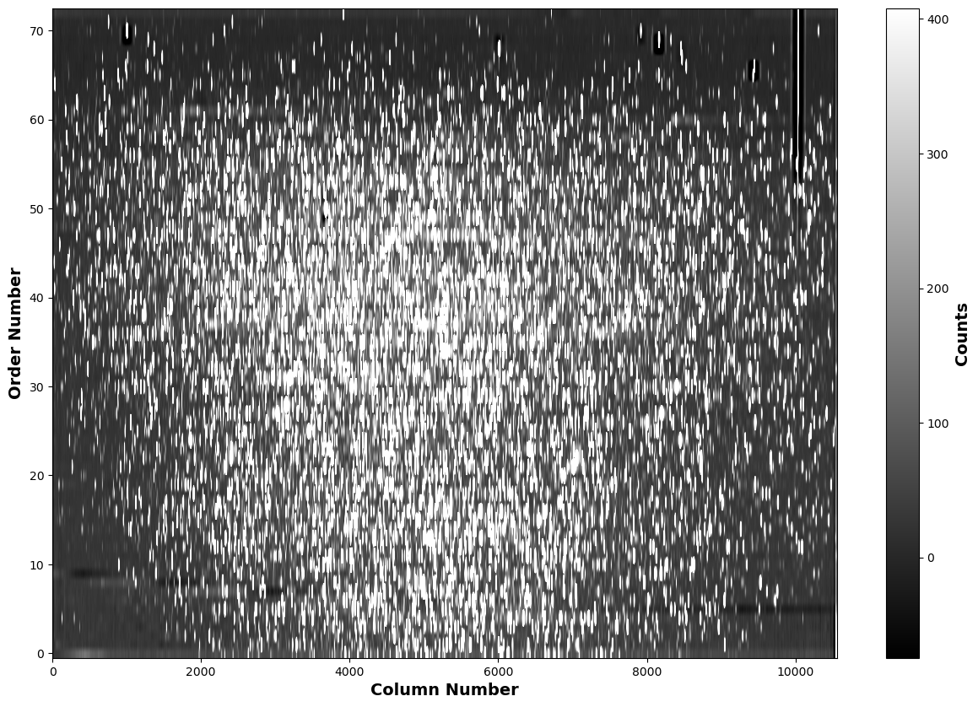
Day 5: ThAr Wavelength calibration

Slide 21
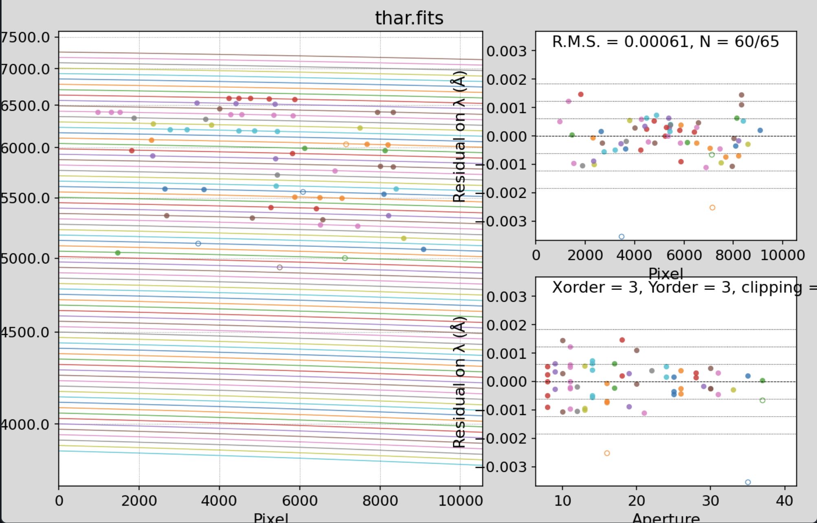
Day 5: ThAr Wavelength calibration
Credit: Liang Wang

